Slide 1
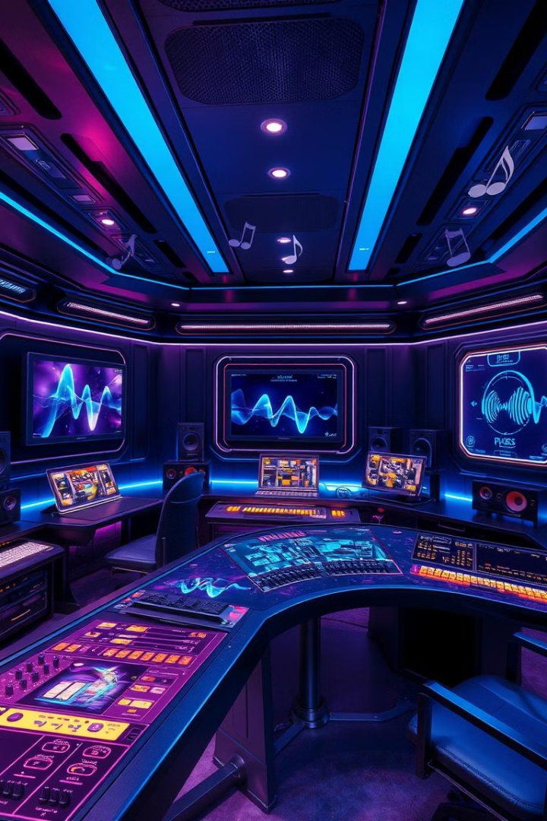
The Impact of AI on the Music Industry
Exploring the evolving role of artificial intelligence in music creation, production, and consumption
by sina Farzaneh

Slide 2

Introduction: The Rise of AI in Music
Automation
Personalization
New Creative Possibilities
AI tools are changing how music is created, produced, and consumed
Tailored experiences for listeners, from recommendations to customized playlists
AI is expanding the boundaries of music creation

Slide 3
Automated Music Composition
Generative AI
Composition Styles
AI algorithms can create entire musical pieces
From classical to pop, AI is creating music in various genres

Slide 4
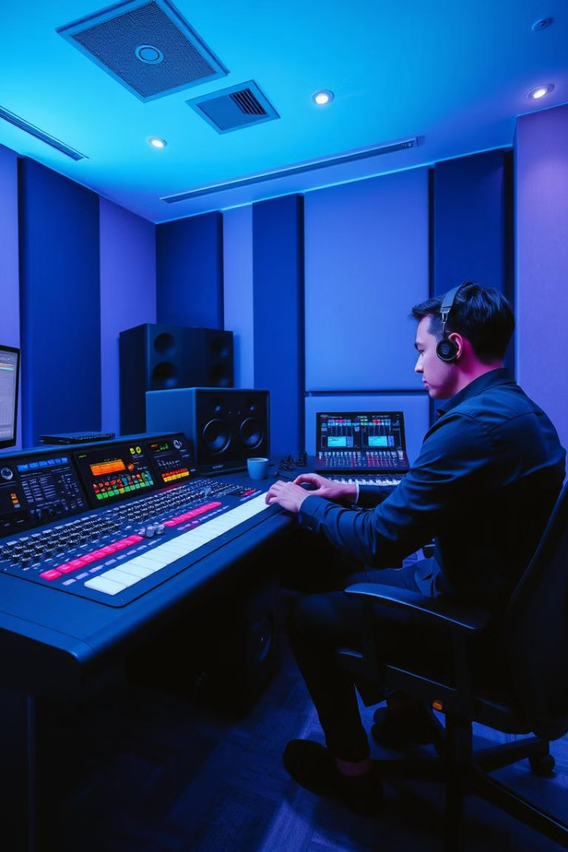


AI-Powered Music Production
Mixing and Mastering
AI can automate mixing, mastering, and sound design tasks
Sound Enhancement
AI tools enhance audio quality, remove noise, and improve clarity

Slide 5
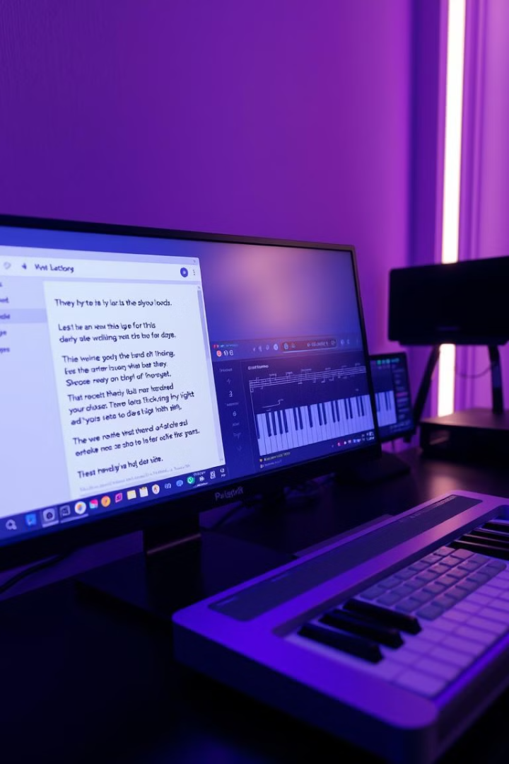


AI-Generated Music Lyrics and Melodies
Lyric Generation
AI can generate creative and relevant lyrics
Melody Composition
AI creates original melodies based on specific parameters

Slide 6



Personalized Music Recommendations
Understanding Preferences
1
AI analyzes listening habits and preferences
Personalized Playlists
2
Curated playlists based on individual tastes
Enhanced Discovery
3
AI suggests new music based on user data

Slide 7
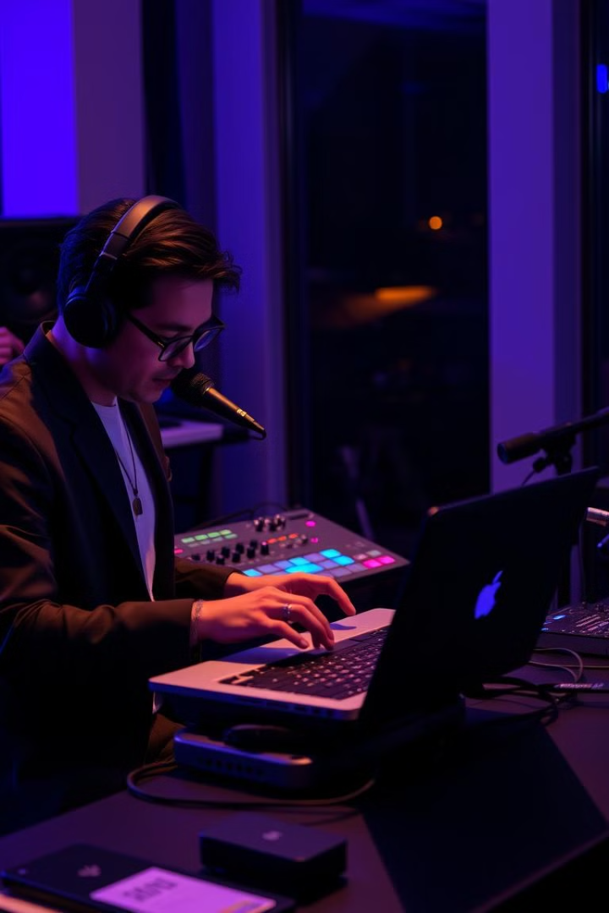
Impact on the Creative Process
New Tools
AI tools augment human creativity, not replace it
Collaboration
Human-AI collaboration opens up new possibilities
Inspiration
AI can spark new ideas and push creative boundaries

Slide 8
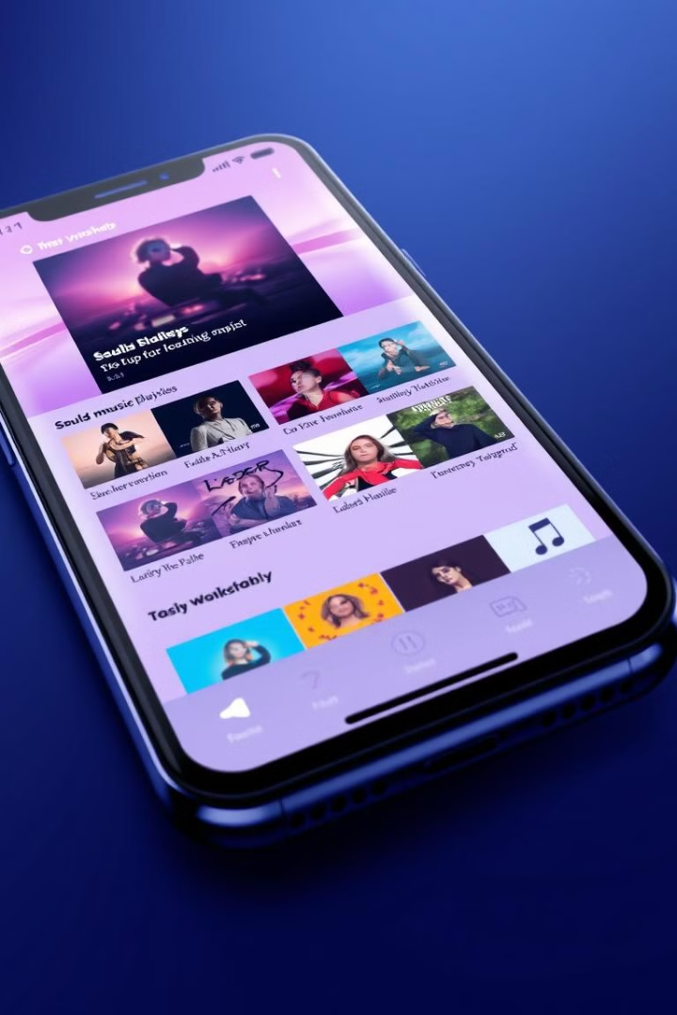
AI and the Music Streaming Industry
3
Personalized Playlists
AI powers personalized playlists based on user preferences
4
Improved Recommendations
AI algorithms provide more relevant music suggestions
7
Enhanced User Experience
AI improves the overall user experience of streaming services

Slide 9

Digital Right Management With AI
1
2
3
Copyright and Ownership
Artist Identity
Data Privacy

Slide 10
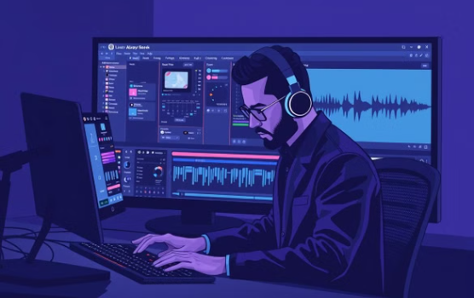
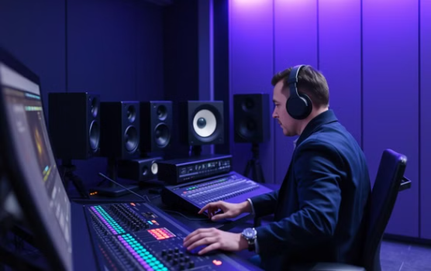
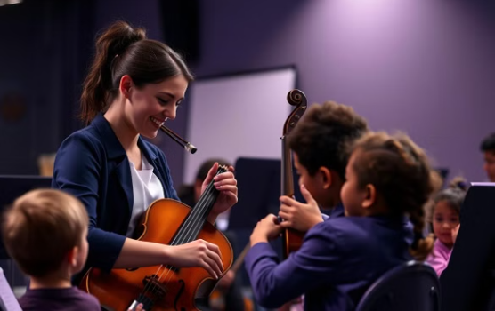
Opportunities for Music Professionals

